Slide 1
GT Identity and Access Management JA-SIG CAS project (introducing login.gatech.edu)
April 29th, 2009

Slide 2
Who will this affect
Today:
OIT developers, OIT end users, OIT support staff
Followed by:
CSR’s, Campus Developers, Support Staff
Finally:
Almost every GT web user.

Slide 3
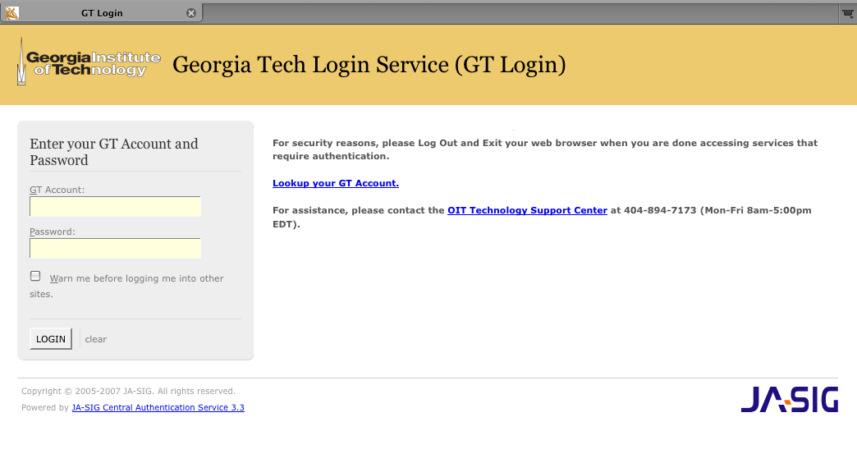
login.gatech.edu
GT branded as login.gatech.edu
Standard SSO solution from JA-SIG called CAS (Central Authentication Service)
Widely used and documented especially in higher ED
Will replace webauth.gatech.edu

Slide 4
What is changing?
New features or functionality of login.gatech.edu
Single Sign On by default: login once for many apps.
SSO controls: i.e. force rechecking of password
Central logout page for applications to use
Application Registration: Reporting, Theme, Additional Attributes per application
Complete CAS protocol support
Lost features or functionality of webauth.gatech.edu
No Bounce API: custom GT API presents security concern

Slide 5
Migration Paths
Sites moving to login.gatech.edu fall into one of two groups
Each site may migrate independent of each other
CAS or “old” API
Small configuration change
Similar or same protocols supported by login.gatech.edu
User will see new login site
Bounce API
May require some development work
User facing change

Slide 6
Site Statistics
Monthly usage reports
Shows site API
Show unique users
Shows URL or host name
Top 3 Sites of 250 total
Site | Logins | Users | API
mail.gatech.edu | 945094 | 22645 | Bounce
t-square.gatech.edu | 445912 | 17345 | CAS
www.library.gatech.edu | 42055 | 8206 | CAS

Slide 7
User Experience
Application page with login button
t-square
Redirect through login.gatech.edu if no application session.
User sees login.gatech.edu and logs in if no SSO session
Login is authenticated with no intermediate page if SSO session exists
Default behavior, user or application can override
Application or Web server can implement

Slide 8
How To’s:
http://share-it.gatech.edu/oit/iam/login-1
As an apache module, replacement for basic auth
With php code or module
As an IIS plugin
As a java filter: tomcat, j2ee apps, etc.
Lots more!

Slide 9
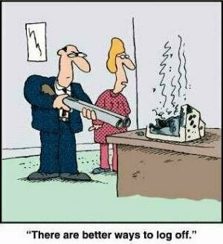
The logout dilemma

Slide 10
Dashboard/Wrapup
Today login.gatech.edu is available for early adopters
Milestones
Timelines
Sunset webauth 2010

Slide 11
News & Questions
Passport Upgrade 5/16/2009
Password expiration extended from 90 to 120 days
Employees can and should set published email via passport
Regular confirmation of GTENS and published email
GtAccount! No more AD vs Kerberos
Cleanup of hints and buzzcard
Brown bag with CoC this summer
Replace your NIS infrastructure with GTED
Use GRS to manage roles and authorizations

